Slide 1
Classes Operator Overloding

Slide 2
User-Defined Type Conversions
• You can define both implicit and explicit conversions for your own classes and structs. This allows you to convert an object of your user-defined type to some other type, and vice versa.
• C# provides implicit and explicit conversions.
– With an implicit conversion, the compiler will automatically make the conversion, if necessary, when it is resolving what types to use in a particular context.
– With an explicit conversion, the compiler will only make the conversion when an explicit cast operator is used.
The syntax for declaring an implicit conversion is the following. The public and static modifiers are required for all user-defined conversions.

Slide 3
Required Target Source
↓ ↓ ↓
public static implicit operator TargetType ( SourceType Identifier )
{
...
return ObjectOfTargetType;
}
The syntax for the explicit conversion is the same, except that explicit is substituted for
implicit.
The following code shows an example of declarations for conversion operators that will
convert an object of type LimitedInt to type int, and vice versa.

Slide 4
class LimitedInt Target Source
{ ↓ ↓
public static implicit operator int (LimitedInt li)
{
return li.TheValue;
} Target Source
↓ ↓
public static implicit operator LimitedInt (int x)
{
LimitedInt li = new LimitedInt();
li.TheValue = x;
return li;
}
private int _TheValue = 0;
public int TheValue{ ... }
}

Slide 5
class LimitedInt
{
const int MaxValue = 100;
const int MinValue = 0;
public static implicit operator int(LimitedInt li) // Convert type
{
return li.TheValue;
}
public static implicit operator LimitedInt(int x) // Convert type
{
LimitedInt li = new LimitedInt();
li.TheValue = x;
return li;
}
private int _TheValue = 0;
public int TheValue // Property
{
get { return _TheValue; }
set
{
if (value < MinValue)
_TheValue = 0;
else
_TheValue = value > MaxValue ? MaxValue: value;
}
}
}

Slide 6
class Program
{
static void Main() // Main
{
LimitedInt li = 5; // Convert 5 to LimitedInt
int Five = li; // Convert LimitedInt to int
Console.WriteLine("li: {0}, Five: {1}", li.TheValue, Five);
}
}

Slide 7
Explicit Conversion and the Cast Operator
The preceding example code showed the implicit conversion of the int to a LimitedInt type and the implicit conversion of a LimitedInt type to an int. If, however, you had declared the two conversion operators as explicit, you would have had to explicitly use cast operators when making the conversions.
A cast operator consists of the name of the type to which you want to convert the expression, inside a set of parentheses. For example, in the following code, method Main casts the value 5 to a LimitedInt object.
Cast operator
↓
LimitedInt li = (LimitedInt) 5;

Slide 8
↓
public static explicit operator int(LimitedInt li)
{
return li.TheValue;
}
↓
public static explicit operator LimitedInt(int x)
{
LimitedInt li = new LimitedInt();
li.TheValue = x;
return li;
}
static void Main()
{ ↓
LimitedInt li = (LimitedInt) 5;
int Five = (int) li;
↑
Console.WriteLine(" li: {0}, Five: {1}", li.TheValue, Five);
}

Slide 9
Operator Overloading
The C# operators, as you’ve seen, are defined to work using the predefined types as operands.If confronted with a user-defined type, an operator simply would not know how to process it. Operator overloading allows you to define how the C# operators should operate on operands of your user-defined types.
• Operator overloading is only available for classes and structs.
• You can overload an operator x for use with your class or struct by declaring a method named operator x that implements the behavior (e.g., operator +, operator -, etc.).
– The overload methods for unary operators take a single parameter of the class or struct type.
– The overload methods for binary operators take two parameters, at least one of which must be of the class or struct type.

Slide 10
public static LimitedInt operator -(LimitedInt x) // Unary
public static LimitedInt operator +(LimitedInt x, double y) // Binary
An operator overload method must be declared
• With both static and public modifiers
• As a member of the class or struct for which it is an operand
The following code shows two of the overloaded operators of class LimitedInt: the addition operator and the negation operator. You can tell that it is negation and not subtraction because the operator overload method has only a single parameter, and is therefore unary; whereas the subtraction operator is binary.

Slide 11
class LimitedInt Return
{ required type Keyword Operator Operand
↓ ↓ ↓ ↓ ↓
public static LimitedInt operator + (LimitedInt x, double y)
{
LimitedInt li = new LimitedInt();
li.TheValue = x.TheValue + (int)y;
return li;
}
public static LimitedInt operator - (LimitedInt x)
{
// In this strange class, negating a value just sets its value to 0.
LimitedInt li = new LimitedInt();
li.TheValue = 0;
return li;
}
...
}

Slide 12
Restrictions on Operator Overloading
Not all operators can be overloaded, and there are restrictions on the types of overloading that can be done. The important things you should know about the restrictions on operator overloading are described later in the section.
Only the following operators can be overloaded. Prominently missing from the list is the assignment operator.
Overloadable unary operators: +, -, !, ~, ++, --, true, false
Overloadable binary operators: +, -, *, /, %, &, |, ^, <<, >>, ==, !=, >, <, >=, <=
The increment and decrement operators are overloadable. But unlike the predefined versions,there is no distinction between the pre- and post- usage of the overloaded operator.
You cannot do the following things with operator overloading:
• Create a new operator
• Change the syntax of an operator
• Redefine how an operator works on the predefined types
• Change the precedence or associativity of an operator

Slide 13
The following example shows the overloads of three operators for class LimitedInt: negation, subtraction, and addition.
class LimitedInt
{
const int MaxValue = 100;
const int MinValue = 0;
public static LimitedInt operator -(LimitedInt x)
{
// In this strange class, negating a value just sets its value to 0.
LimitedInt li = new LimitedInt();
li.TheValue = 0;
return li;
}
public static LimitedInt operator -(LimitedInt x, LimitedInt y)
{
LimitedInt li = new LimitedInt();
li.TheValue = x.TheValue - y.TheValue;
return li;
}

Slide 14
public static LimitedInt operator +(LimitedInt x, double y)
{
LimitedInt li = new LimitedInt();
li.TheValue = x.TheValue + (int)y;
return li;
}
private int _TheValue = 0;
public int TheValue
{
get { return _TheValue; }
set
{
if (value < MinValue)
_TheValue = 0;
else
_TheValue = value > MaxValue
? MaxValue
: value;
}
}
}

Slide 15
class Program
{
static void Main()
{
LimitedInt li1 = new LimitedInt();
LimitedInt li2 = new LimitedInt();
LimitedInt li3 = new LimitedInt();
li1.TheValue = 10; li2.TheValue = 26;
Console.WriteLine(" li1: {0}, li2: {1}", li1.TheValue, li2.TheValue);
li3 = -li1;
Console.WriteLine("-{0} = {1}", li1.TheValue, li3.TheValue);
li3 = li2 - li1;
Console.WriteLine(" {0} - {1} = {2}",
li2.TheValue, li1.TheValue, li3.TheValue);
li3 = li1 - li2;
Console.WriteLine(" {0} - {1} = {2}",
li1.TheValue, li2.TheValue, li3.TheValue);
}
}
li1: 10, li2: 26
-10 = 0
26 - 10 = 16
10 - 26 = 0

Slide 16
public class Complex
{
private double m_dReal, m_dImaginary;
public double Real
{
get { return m_dReal; }
set { m_dReal = value; }
}
public double Imaginary
{
get { return m_dImaginary; }
set { m_dImaginary = value; }
}
// binary operator overloading
public static Complex operator +(Complex c1, Complex c2)
{
return new Complex() { Real = c1.Real + c2.Real, Imaginary =
c1.Imaginary + c2.Imaginary };
}

Slide 17
// unary operator overloading
public static Complex operator -(Complex c)
{
return new Complex() { Real = -c.Real, Imaginary =
-c.Imaginary };
}
// cast operator overloading (both implicit and explicit)
public static implicit operator double(Complex c)
{
// return the modulus - sqrt(x^2 + y^2)
return Math.Sqrt(Math.Pow(c.Real, 2) + Math.Pow(c.Imaginary, 2));
}
public static explicit operator string(Complex c)
{
// we should be overloading the ToString() method, but this is just a demonstration
return c.Real.ToString() + " + " + c.Imaginary.ToString() + "i";
}
}

Slide 18
public class StaticDemo
{
public static void Main()
{
Complex number1 = new Complex() { Real = 1, Imaginary = 2 };
Complex number2 = new Complex() { Real = 4, Imaginary = 10 };
Complex number3 = number1 + number2;
// number3 now has Real = 5, Imaginary = 12
number3 = -number3;
// number3 now has Real = -5, Imaginary =-12
double testNumber = number3;
// testNumber will be set to the absolute value of number3
Console.WriteLine((string)number3); // This will print "-5 + -12i".
// The cast to string was needed because that was an explicit cast operator.
}
}

Slide 19
public class StaticDemo
{
public static void Main()
{
Complex number1 = new Complex() { Real = 1, Imaginary = 2 };
Complex number2 = new Complex() { Real = 4, Imaginary = 10 };
Complex number3 = number1 + number2;
// number3 now has Real = 5, Imaginary = 12
number3 = -number3;
// number3 now has Real = -5, Imaginary =-12
double testNumber = number3;
// testNumber will be set to the absolute value of number3
Console.WriteLine((string)number3); // This will print "-5 + -12i".
// The cast to string was needed because that was an explicit cast operator.
}
}

Slide 20
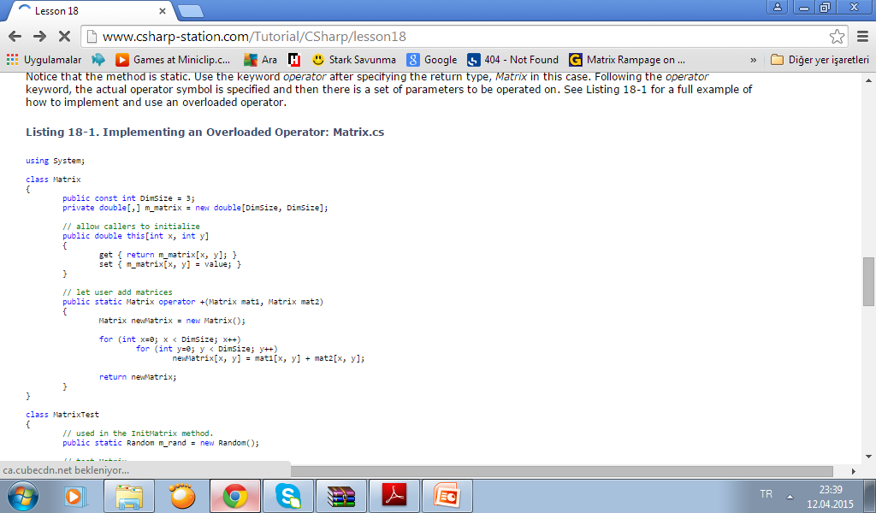

Slide 21
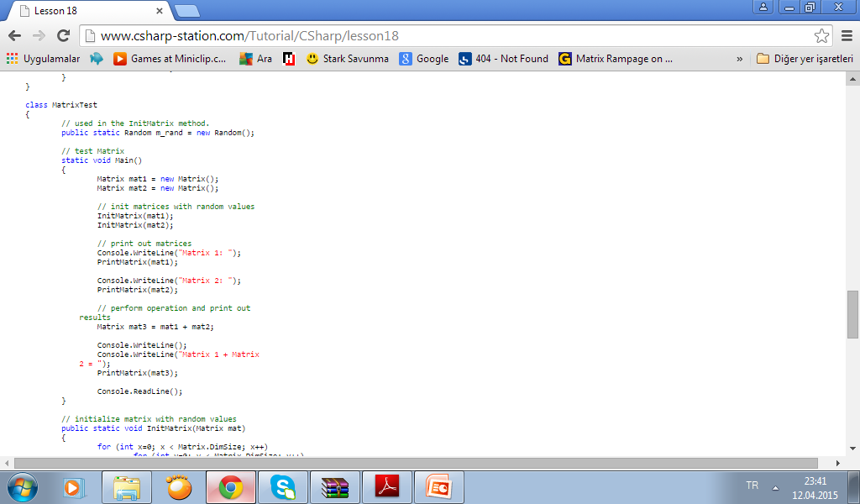

Slide 22
